Slide 1
CORRELATION & LINEAR REGRESSION

Slide 2
GOAL :
Understand and interpret the terms dependent variable and independent variable.
Draw a scatter diagram.
Calculate and interpret the coefficient of correlation, the coefficient of determination, and the standard error of estimate.

Slide 3
Linear Regression
& correlation
Correlation
Regression
Analysis
Strength of
the relationship
Least square model
Coefficient of
correlation
Assumption of the
least square model
Standard error of
the estimate

Slide 4
Correlation Analysis
The study of the relationship between variables
or
A group of techniques to measure the strength of the association between two variables
Note that here we consider two variables
  One is the independent variable
  The second is the dependent variable,

Slide 5
Variables
The Independent Variable provides the basis for estimation. It is the predictor variable. It is scaled on X axis.
The Dependent Variable is the variable being predicted or estimated. It is scaled on Y-axis.

Slide 6
Scatter Diagram
A chart that portrays the relationship between the two variables.
Dependent variable – vertical (or Y) axis
Independent variable – horizontal (or X) axis

Slide 7
EXAMPLE 1
Chaminda Liyanage , the president of IMSSA, is concerned about the cost to students of textbooks. He believes there is a relationship between the number of pages in the text and the selling price of the book. To provide insight into the problem he selects a sample of eight textbooks currently on sale in the bookstore.
Draw a scatter diagram.

Slide 8
EXAMPLE 1
Book Page Price ($)
Operation Re search 500 84
Basic Algebra 700 75
Economics 800 99
Management Science 600 72
Business Management 400 69
Industrial law 500 81
Human Resource 600 63
Information Technology 800 93

Slide 9
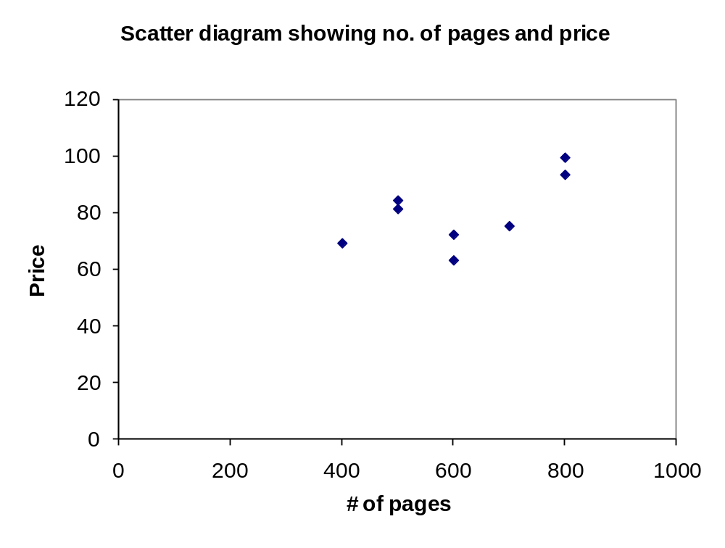
Example 1

Slide 10
Correlation Analysis
Correlation Analysis is a group of statistical techniques used to measure the strength of the association between two variables.
The Coefficient of Correlation (r) is a measure of the strength of the relationship between two variables.

Slide 11
The Coefficient of Correlation (r)
A measure of the strength of the linear relationship between two variables.
It can range from -1.00 to 1.00.
Values of -1.00 or 1.00 indicate perfect and strong correlation.
Negative values indicate an inverse relationship
Positive values indicate a direct relationship.
Values close to 0.0 indicate weak correlation

Slide 12
The strength and direction of the correlation
Perfect Negative correlation
No correlation
Perfect Positive correlation
Moderate Negative correlation
Moderate Positive correlation
Strong Negative correlation
Weak Negative correlation
Weak Positive correlation
Strong Positive correlation
-1.00
-0.50
0
0.50
1.00
Negative correlation
Positive correlation

Slide 13
Perfect Negative Correlation
10
9
8
7
6
5
4
3
2
1
0
Y
0 1 2 3 4 5 6 7 8 9 10
X

Slide 14
Perfect Positive Correlation
10
9
8
7
6
5
4
3
2
1
0
Y
0 1 2 3 4 5 6 7 8 9 10
X

Slide 15
Strong Positive Correlation
10
9
8
7
6
5
4
3
2
1
0
Y
0 1 2 3 4 5 6 7 8 9 10
X

Slide 16
Zero Correlation
10
9
8
7
6
5
4
3
2
1
0
Y
0 1 2 3 4 5 6 7 8 9 10
X

Slide 17
EXAMPLE 1
Compute the correlation coefficient, interpret the strength.
Determine the coefficient of determination and interpret.

Slide 18
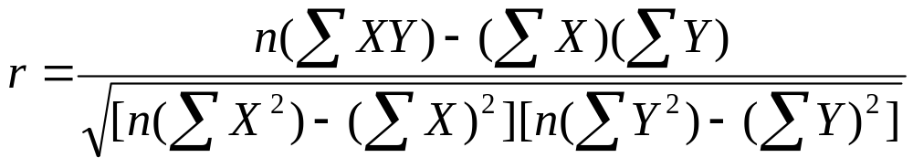
Coefficient of correlation (r)
Formula for coefficient of correlation or (correlation coefficient )

Slide 19
Coefficient of Determination (r²)
The proportion of the total variation in the dependent variable (Y) that is explained or accounted for, by the variation in the independent variable (X).
It is the square of the coefficient of correlation.
It ranges from 0 to 1.
It does not give any information on the direction of the relationship between the variables.

Slide 20
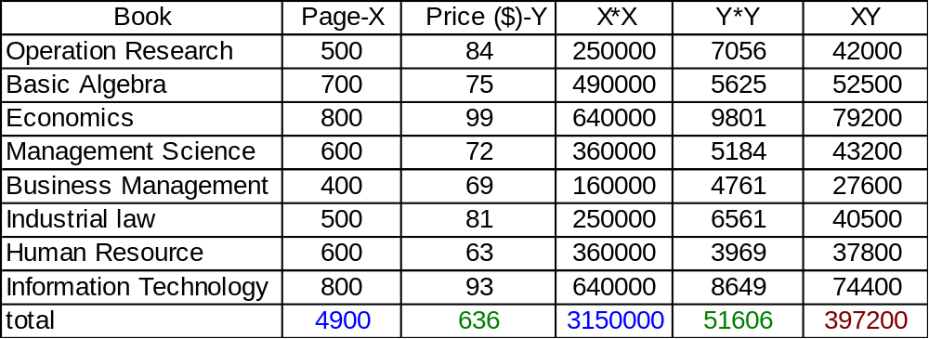
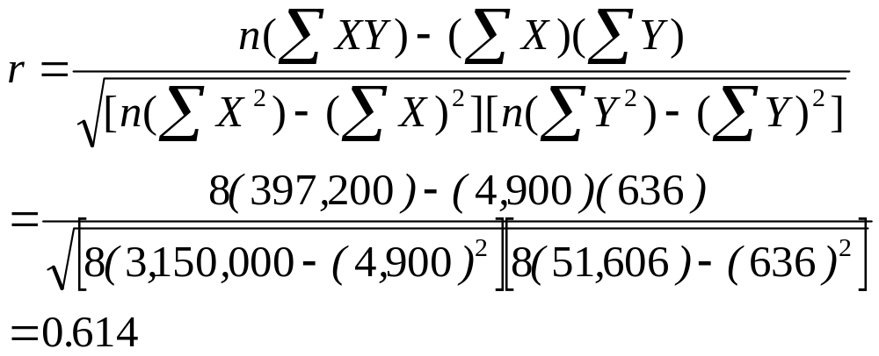
Example 1 continued

Slide 21
EXAMPLE 1 continued
The correlation between the number of pages and the selling price of the book is r =0.614.
  This indicates a moderate association between the variable.
Coefficient of determination r² ⁼ 0.376
  37.6% of the variation in the price of the book is accounted by variation on the page number

Slide 22
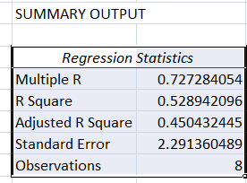
Exercise
A production supervisor wishes to find the relationship between the number of workers on a job and the number of units produced for a shift. Listed below is the result for a sample of 8 days.
Workers Units
9 12
3 14
5 9
7 14
12 17
6 13
13 17
4 9
a. Identify the dependent and independent variable
b. Determine the coefficient of correlation
c. Determine the coefficient of determination
d. Interpret your findings in a. and b.

Slide 23
Regression Analysis
In regression analysis we use the independent variable (X) to estimate the dependent variable (Y).
The relationship between the variables is linear.
Both independent and dependent variable must be interval or ratio scale.
The least squares criterion is used to determine the regression equation.

Slide 24
Least Squares Principle
Gives the best fitting line
Minimizes the sum of the squares of the vertical distance between the actual “y” values and the predicted “y” values
Regression line is determined by using a mathematical method

Slide 25
Regression Equation
Y’ = a + bX,
where:
Y’ is the average predicted value of Y (or estimated value of y) for a selected value of X.
a is the constant or Y-intercept.
  It is the estimated Y’ value when X=0
b is the slope of the line,
Shows the amount of change in Y’ for a change of one unit in X
Positive value of b indicates a direct relationship between two variables
Negative value of b indicates an inverse relationship

Slide 26
Regression Equation
a is computed using;
b is computed using;
Σ
Y
Σ
X
a
=
−
b
n
n
n
(
Σ
XY
)
−
(
Σ
X
)(
Σ
Y
)
b
=
n
(
Σ
X
2
)
−
(
Σ
X
)
2

Slide 27
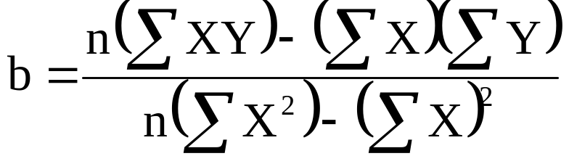
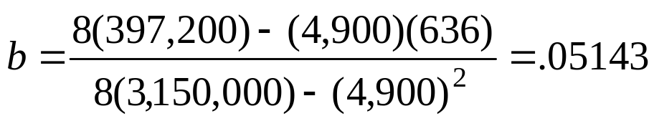
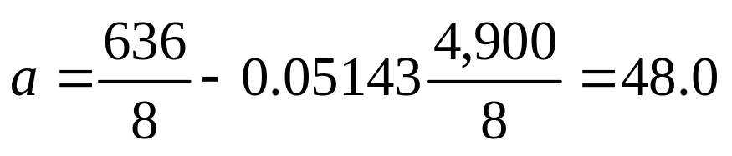
Develop a regression equation for the information given in EXAMPLE 1 that can be used to estimate the selling price based on the number of pages
Σ
Y
Σ
X
a
=
−
b
n
n

Slide 28
The regression equation is:
Y’ = 48.0 + .05143X
The equation crosses the Y-axis at $48.
A book with no pages would cost $48.
The slope of the line is 0.05143.
Each addition page costs about 0.05 cents
The sign of the b value and the sign of r will always be the same.

Slide 29
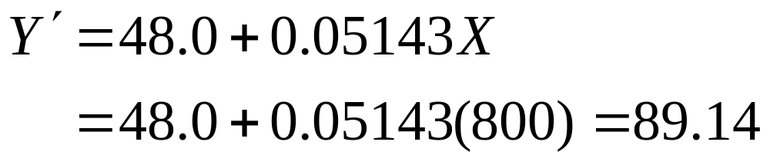
EXAMPLE 1
We can use the regression equation to estimate values of Y.
The estimated selling price of an 800 page book is $89.14, found by

Slide 30
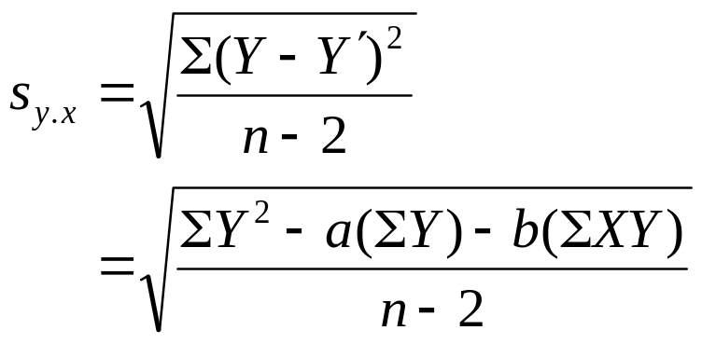
The Standard Error of Estimate
The standard error of estimate measures the scatter, or dispersion or the variation, of the observed values around the line of regression
  It is in the same units as the dependent variable
  It is based on the squared deviations from the regression line
  Small values indicate that the points cluster closely about the regression line

Slide 31
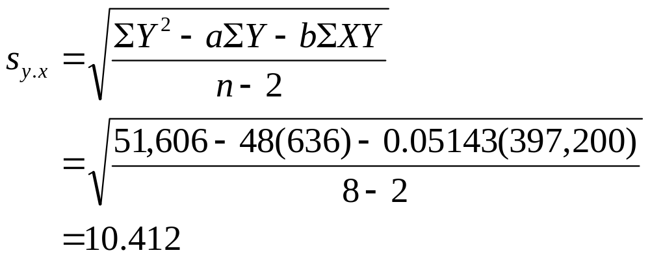
Find the standard error of estimate for the problem involving the number of pages in a book and the selling price in Example 1
We can use the regression equation to estimate values of Y.
The estimated selling price of an 800 page book is $89.14, found by
68% of the prices of books with page 800 falls between $89.14±10.41

Slide 32
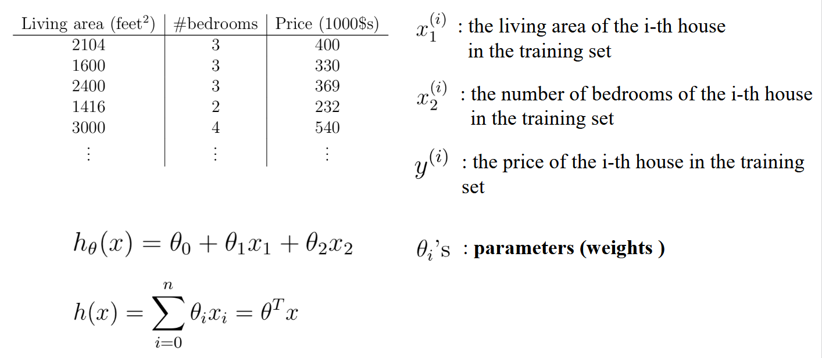

Slide 33
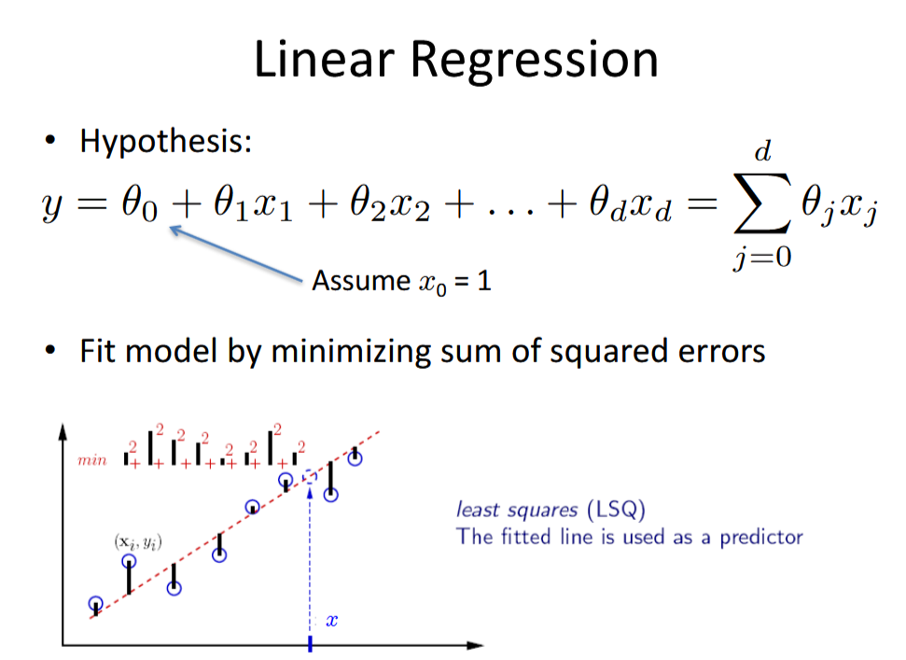

Slide 34
cost function
In simple terms, it calculates how far off the predicted values (generated by the model) are from the actual values.
The cost function quantifies the difference between the model’s predictions and the actual outcomes for each data point in the dataset.
The goal in linear regression is to find the line (or hyperplane, in the case of multiple variables) that minimizes this difference, thereby creating the most accurate model.

Slide 35
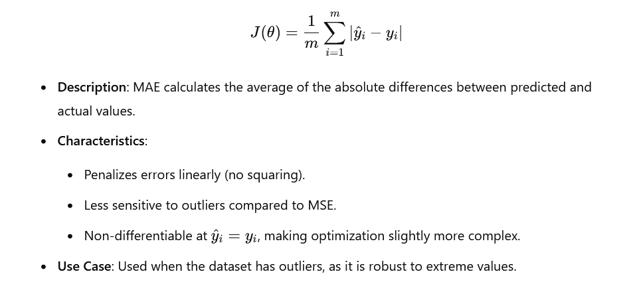
Mean Absolute Error

Slide 36
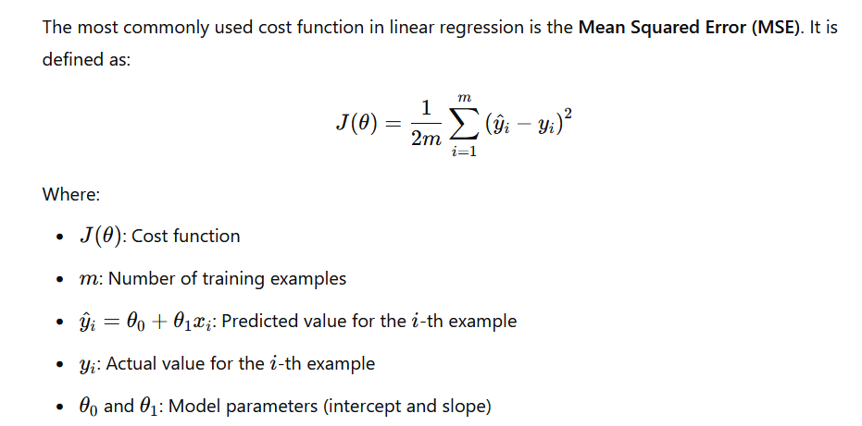
Mean Squared Error (MSE)

Slide 37
The Least Squares (Regression) Line
Sum of squared differences =
(2 - 1)² +
(4 - 2)² +
(1.5 - 3)² +
(3.2 - 4)² = 6.89
Sum of squared differences =
(2 -2.5)² +
(4 - 2.5)² +
(1.5 - 2.5)² +
(3.2 - 2.5)² = 3.99
Let us compare two lines
4
(2,4)
⬥
The second line is horizontal
(4,3.2)
3
⬥
2.5
2
⬥
(1,2)
(3,1.5)
⬥
The smaller the sum of
squared differences
the better the fit of the
line to the data.
1
1
2
3
4

Slide 38
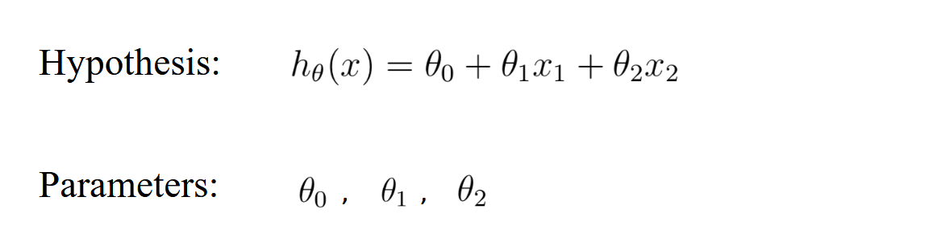
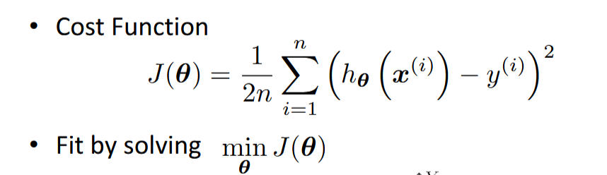

Slide 39
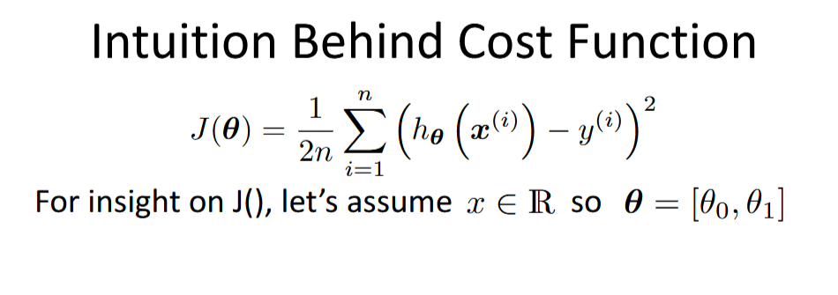

Slide 40
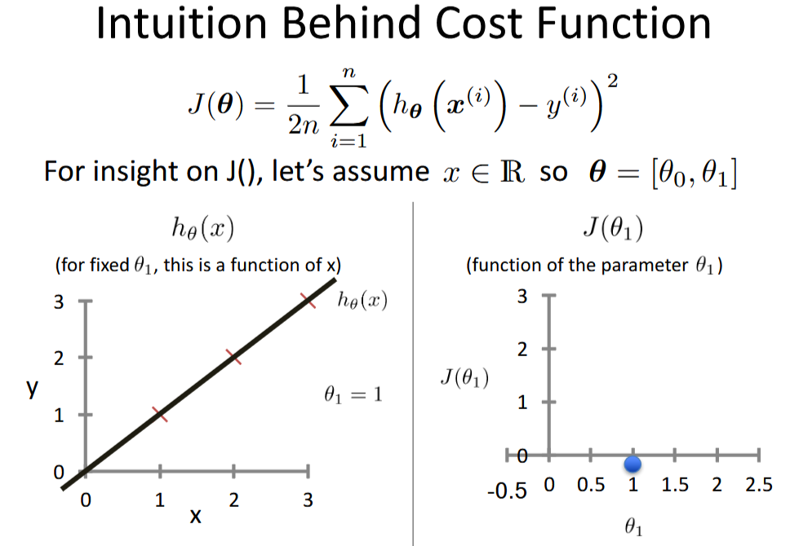

Slide 41
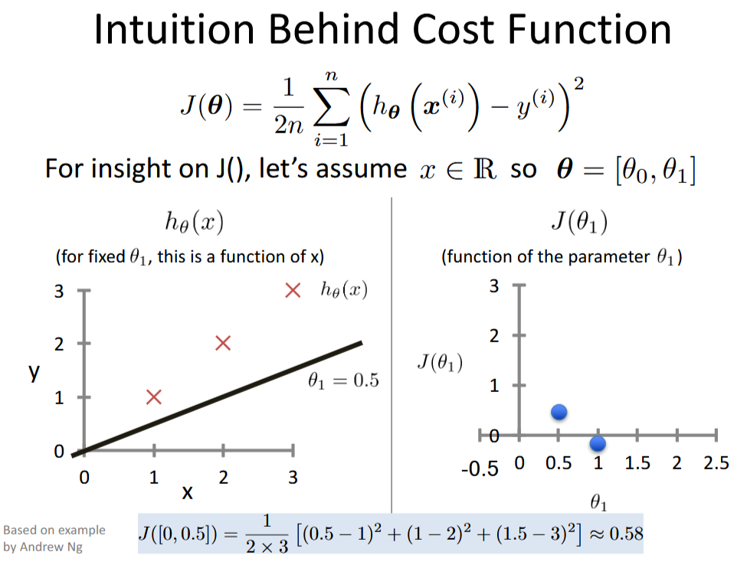

Slide 42
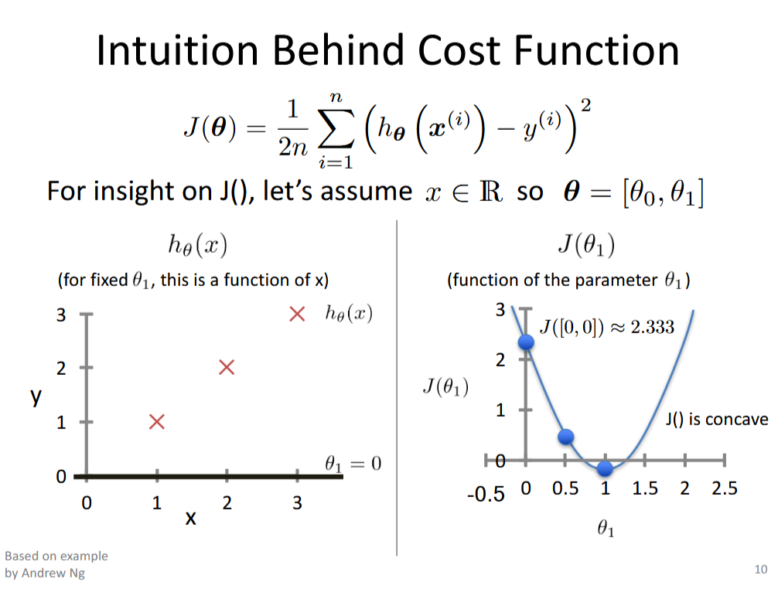

Slide 43
